Slide 1
Causal inference and discovery Pierre Gentine + Adam Massmann + Jakob Runge

Slide 2
Causal Effects

Slide 3
Introduction
Causal inference:
Going beyond correlation, but at cause and effects
Introduction to directed graphs
Do calculus
Transportability

Slide 4
Introduction
Causality in many fields
Economics
Science
Politics
Medicine

Slide 5
Introduction
Causality in economics

Slide 6
Introduction
Causality in human behavior

Slide 7
Introduction
Causality in human behavior

Slide 8
Counterfactual reasoning

Slide 9
Counterfactual reasoning

Slide 10
Simpson’s paradox

Slide 11
Simpson’s paradox

Slide 12
Simpson’s paradox

Slide 13
Simpson’s paradox

Slide 14
Simpson’s paradox

Slide 15
Simpson’s paradox

Slide 16
Simpson’s paradox

Slide 17
Simpson’s paradox

Slide 18
Simpson’s paradox

Slide 19
Simpson’s paradox

Slide 20
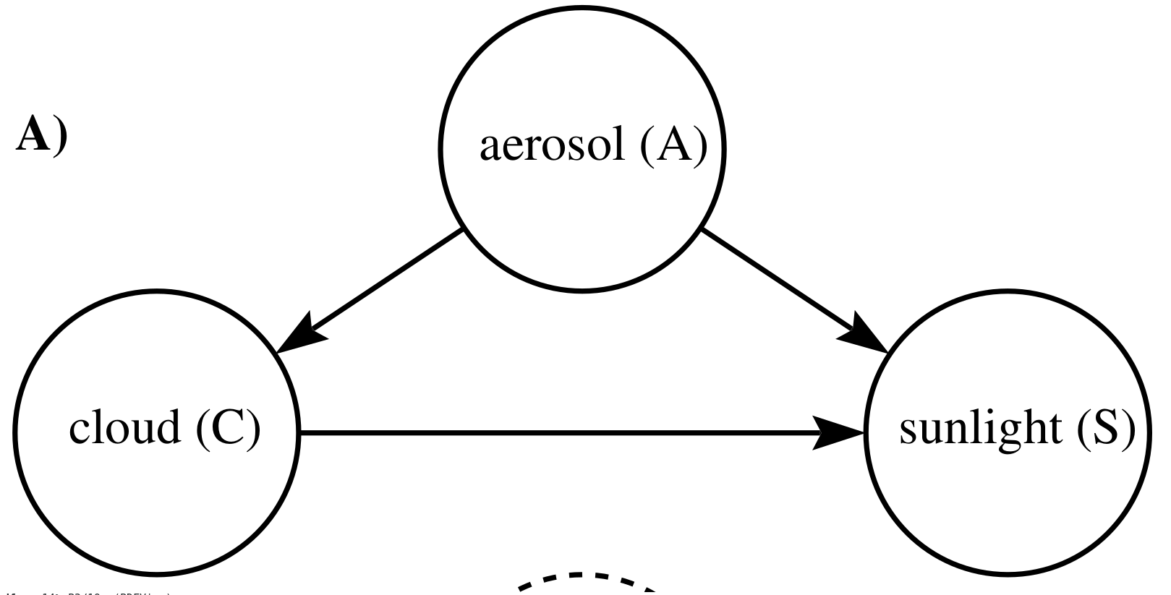
Graphs
Graphs encode assumptions about causal dependencies in the system

Slide 21
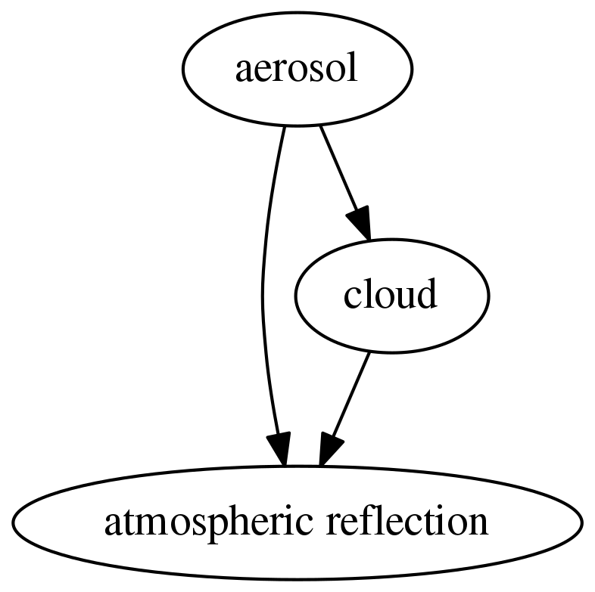
Probabilistic Graphs
Probabilistic graphical models: assumptions and communication
Probabilistic graphical models are directed acyclic graphs (DAGs) encoding assumptions about independence and dependence
Graphs are nice because they communicate a general meaning and a technical meaning:

Slide 22
Causal effects
How would one estimate a causal effect of clouds on surface downwelling solar radiation?

Slide 23
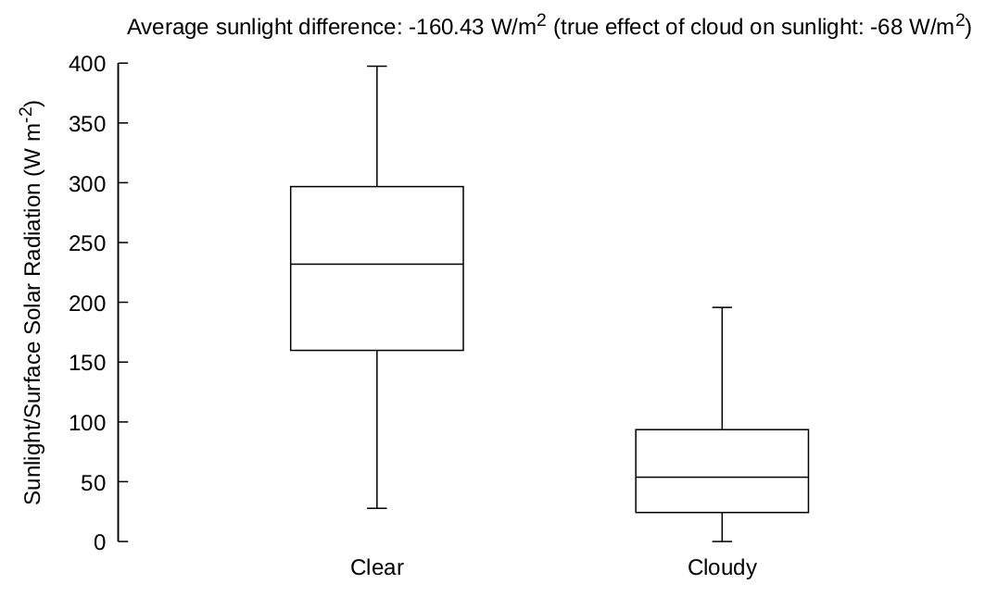
Causal effects
Naive approach (and/or when aerosol data are not available): bin observations by cloudy and clear day and compare the values of sunlight

Slide 24
Causal effects
What went wrong?

Slide 25
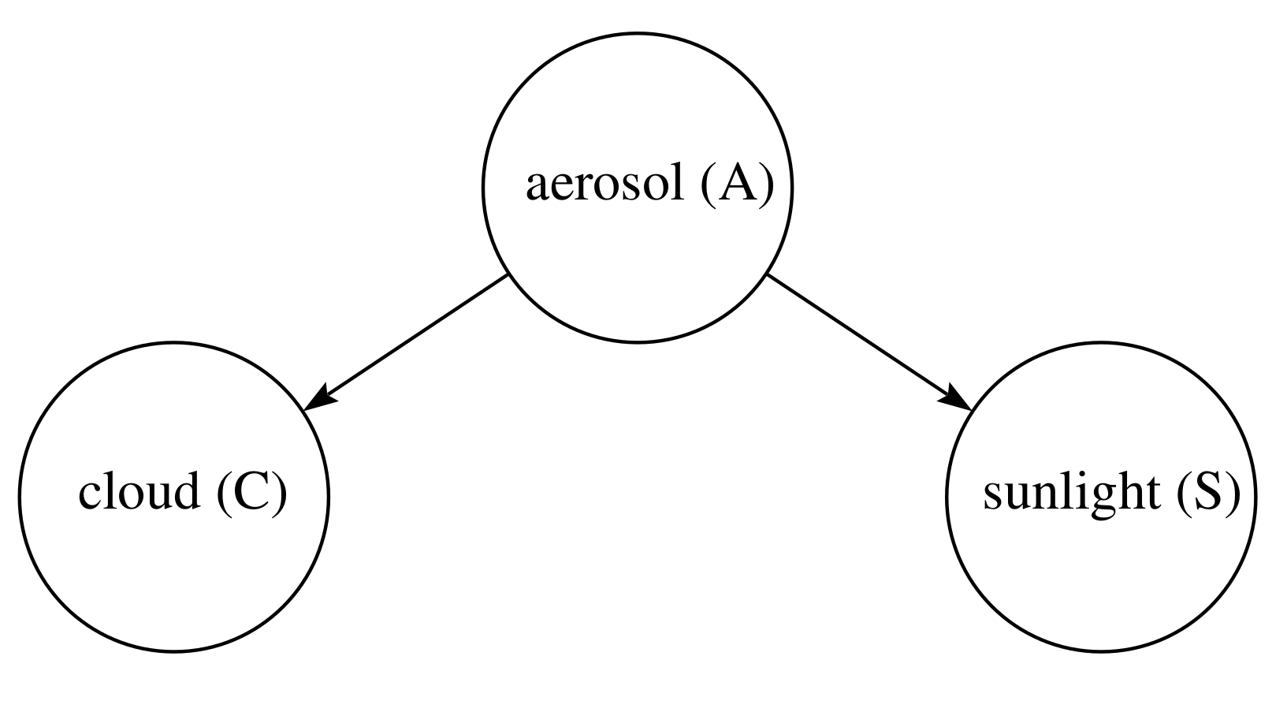
Causal effects
Aerosol induces covariability in cloud and sunlight that has nothing to do with the causal link from cloud to aerosol!

Slide 26
Causal effects
Goal: we want to isolate the variability in aerosol due to the causal link from cloud

Slide 27
Introduction
Intuitive graphical approach: remove causal paths from the cause to the children of causes and ask, are the cause and effect independent in the “mutilated” graph?

Slide 28
Causal effects
If cause and effect are not independent, observe variables such that they are independent

Slide 29
Causal effects

Slide 30
Causal effects

Slide 31
Causal effects

Slide 32
Causal effects

Slide 33
Causal effects

Slide 34
Randomized Control Trials
Question:
How can one, in general, determine whether a certain drug is helpful in reducing the risk of developing a certain desease?
18

Slide 35
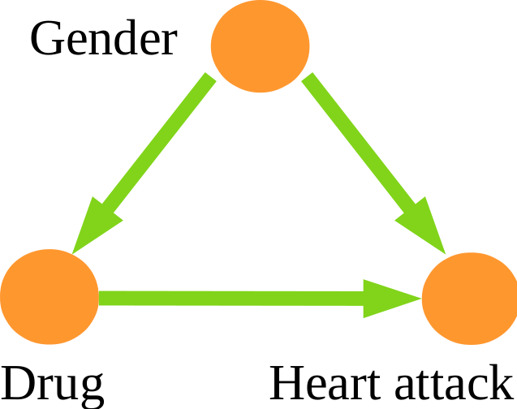
Randomized Control Trials
Question:
How can one, in general, determine whether a certain drug is helpful in reducing the risk of developing a certain desease?
Randomized control trials:
Randomly assign the subjects to the treatment and control group.
18

Slide 36
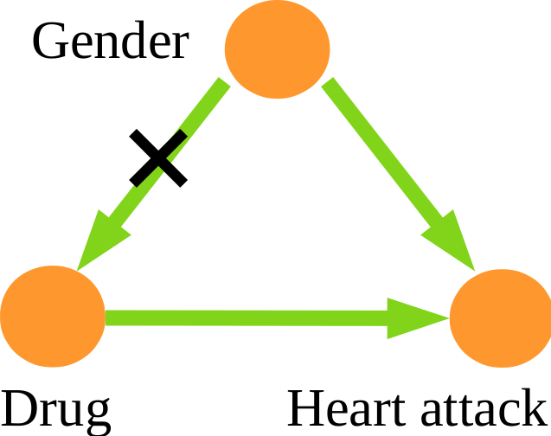
Randomized Control Trials
Question:
How can one, in general, determine whether a certain drug is helpful in reducing the risk of developing a certain desease?
Randomized control trials:
Randomly assign the subjects to the treatment and control group.
18

Slide 37
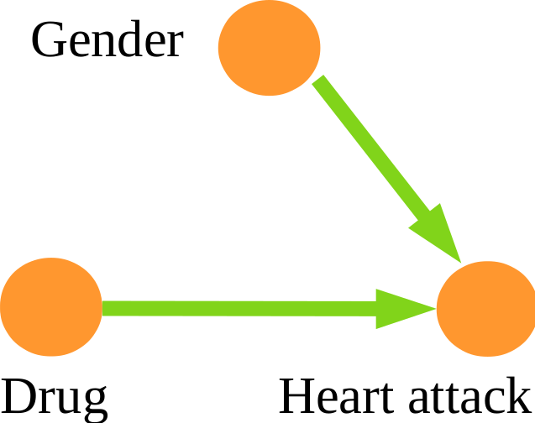
Randomized Control Trials
Question:
How can one, in general, determine whether a certain drug is helpful in reducing the risk of developing a certain desease?
Randomized control trials:
Randomly assign the subjects to the treatment and control group.
The gender of a subject does not longer influence whether a subject belongs to the treatment or control group.
18

Slide 38
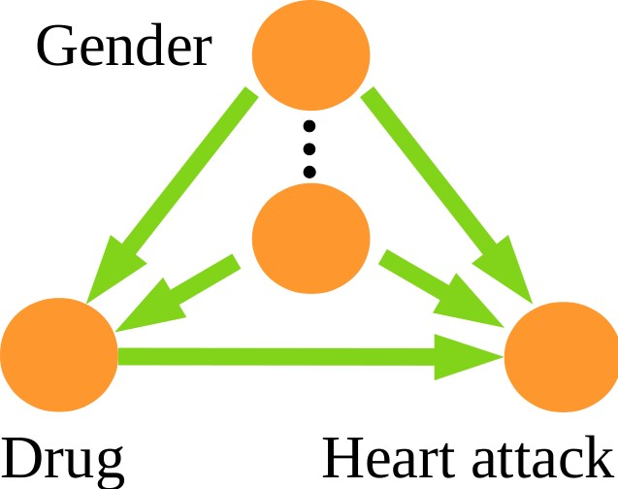
Randomized Control Trials
Question:
How can one, in general, determine whether a certain drug is helpful in reducing the risk of developing a certain desease?
Randomized control trials:
Randomly assign the subjects to the treatment and control group.
18

Slide 39
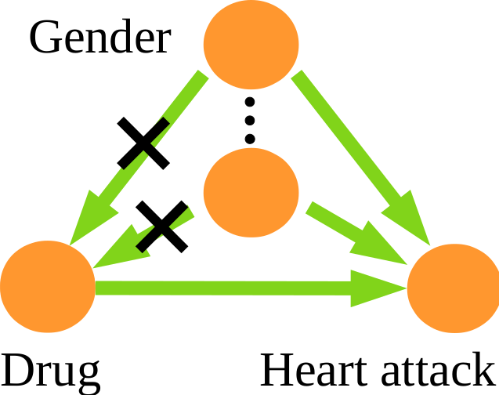
Randomized Control Trials
Question:
How can one, in general, determine whether a certain drug is helpful in reducing the risk of developing a certain desease?
Randomized control trials:
Randomly assign the subjects to the treatment and control group.
17

Slide 40
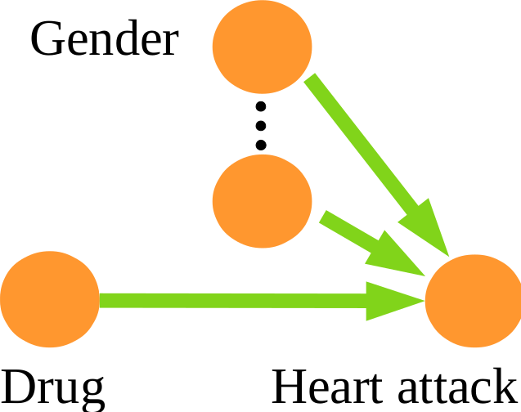
Randomized Control Trials
Question:
How can one, in general, determine whether a certain drug is helpful in reducing the risk of developing a certain desease?
Randomized control trials:
Randomly assign the subjects to the treatment and control group.
In fact, all confounders are eliminated!
16

Slide 41
Randomized Control Trials
Question:
How can one, in general, determine whether a certain drug is helpful in reducing the risk of developing a certain desease?
Randomized control trials:
Randomly assign the subjects to the treatment and control group.
In fact, all confounders are eliminated! Therefore, in RCT data, causal effects can be assessed by statistical proportions.

Slide 42
Experimentation
Abstraction of the question:
Consider two events or variables X and Y . How can we determine whether X causes Y ?
Experimentation:
Experimentally manipulate X while keeping all other conditions exactly the same. If this results in a change of Y , X causes Y .
Such an idealization of experimental manipulation is referred to as an
intervention on X .
16

Slide 43
Experimentation
Abstraction of the question:
Consider two events or variables X and Y . How can we determine whether X causes Y ?
Experimentation:
Experimentally manipulate X while keeping all other conditions exactly the same. If this results in a change of Y , X causes Y .
Such an idealization of experimental manipulation is referred to as an
intervention on X .
Example: Lawn with sprinkler
Turning the sprinkler on makes the lawn wet.
Making the lawn wet does not turn on the sprinkler.
16

Slide 44
Experimentation
Abstraction of the question:
Consider two events or variables X and Y . How can we determine whether X causes Y ?
Experimentation:
Experimentally manipulate X while keeping all other conditions exactly the same. If this results in a change of Y , X causes Y .
Such an idealization of experimental manipulation is referred to as an
intervention on X .
Example: Lawn with sprinkler
Turning the sprinkler on makes the lawn wet.
Making the lawn wet does not turn on the sprinkler.
We need to imagine the lawn being made wet without changing something else, in particular without turning the sprinkler on
16

Slide 45
Challenges in Context of Climate Sciences
When trying to apply these concepts in the context of environmental sciences, we face two fundamental challenges.
17

Slide 46
Challenges in Context of Climate Sciences
When trying to apply these concepts in the context of environmental sciences, we face two fundamental challenges.
Challenge: Experimentation in real environment is not possible
For most parts it is impossible, and else arguably ethically questionable, to deliberately intervene on environmental variables.
Environmental factors
Aerosols
Clouds
17

Slide 47
Challenges in Context of Climate Sciences
When trying to apply these concepts in the context of environmental sciences, we face two fundamental challenges.
Challenge: Experimentation in real environment is not possible
For most parts it is impossible, and else arguably ethically questionable, to deliberately intervene on environmental variables.
Environmental factors
Aerosols
Clouds
17

Slide 48
Challenges in Context of Climate Sciences
When trying to apply these concepts in the context of climate sciences, we face two fundamental challenges.
Challenge: Experimentation in real environment is not possible
For most parts it is impossible, and else arguably ethically questionable, to deliberately intervene on climate variables.
Interventions not possible
Environmental factors
Aerosols
Clouds
17

Slide 49
Challenges in Context of Climate Sciences
When trying to apply these concepts in the context of environmental sciences, we face two fundamental challenges.
Challenge: Experimentation in real environment is not possible
For most parts it is impossible, and else arguably ethically questionable, to deliberately intervene on climate variables.
Environmental factors
Aerosols
Clouds
17

Slide 50
Challenges in Context of Climate Sciences
When trying to apply these concepts in the context of environmental sciences, we face two fundamental challenges.
Challenge: Experimentation in real environment is not possible
For most parts it is impossible, and else arguably ethically questionable, to deliberately intervene on environmental variables.
Challenge: Ground truth not known
Causal relationships are mostly known among microscopic physical variables, but usually less so among macroscopic variables.
17

Slide 51
Challenges in Context of Climate Sciences
When trying to apply these concepts in the context of environmental sciences, we face two fundamental challenges.
Challenge: Experimentation in real environment is not possible
For most parts it is impossible, and else arguably ethically questionable, to deliberately intervene on environmental variables.
Challenge: Ground truth not known
Causal relationships are mostly known among microscopic physical variables, but usually less so among macroscopic variables.
For example:
Is there a causal relationship between arctic sea ice extend in winter and mid latitude weather in summer?
Is there a causal relationship between ENSO and a certain extreme weather event somewhere on Earth?
17

Slide 52
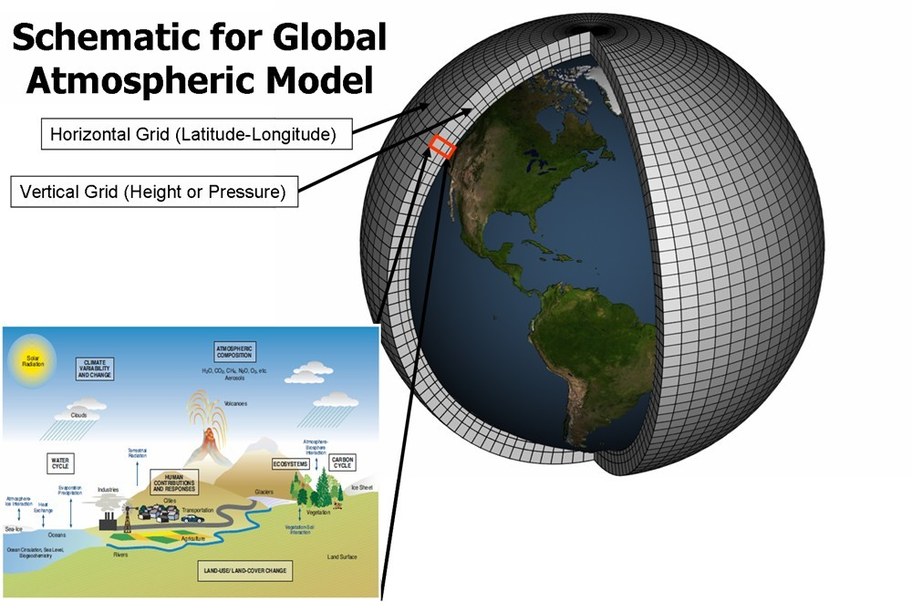
Two Approaches to Address These Challenges
Simulation:
Experimentation in climate models: Fix (intervene on) certain parameters and analyze the resulting effect on other parameters.

Slide 53
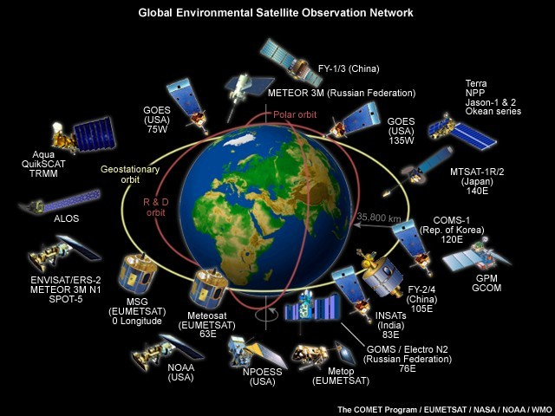
Two Approaches to Address These Challenges
Simulation:
Experimentation in climate models: Fix (intervene on) certain parameters and analyze the resulting effect on other parameters.
Causal inference:
Answer causal questions, for example questions about cause and effect, from observation data.
19

Slide 54


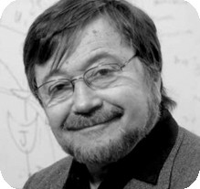

Two Approaches to Address These Challenges
Simulation:
Experimentation in climate models: Fix (intervene on) certain variables and analyze the resulting effect on other variables.
Causal inference:
Answer causal questions, for example questions about cause and effect, from observation data.
Seminal work by Judea Pearl, Peter Spirtes, Clark Glymour, Richard Scheines.
19

Slide 55
Two Approaches to Address These Challenges
Simulation:
Experimentation in climate models: Fix (intervene on) certain parameters and analyze the resulting effect on other parameters.
Causal inference:
Answer causal questions, for example questions about cause and effect, from observation data.
To mathematically treat causal inference, we need to formalize the idea of an underlying structural causal model (SCM), define hypothetical interventions, and establish identifiability criteria to decide if and how causal effects can be estimated from data alone (without interventions).
19

Slide 56

Structural Causal Models
Intuition:
A structural causal model (SCM) specifies the functional causal relationships between a set of random variables.
Example:
Xaerosols = faerosols(Xenv. facs., ηaerosols)
Xclouds. = fclouds(Xaerosols, Xenv. facs., ηclouds)
Xenv. facs. = fenv. facs.(ηenv. facs.)
Environmental factors
Aerosols
Clouds
20

Slide 57
Structural Causal Models
Intuition:
A structural causal model (SCM) specifies the functional causal relationships between a set of random variables.
Example:
Xaerosols = faerosols(Xenv. facs., ηaerosols)
Xclouds. = fclouds(Xaerosols, Xenv. facs., ηclouds)
Xenv. facs. = fenv. facs.(ηenv. facs.)
Environmental factors
Aerosols Clouds
Claims of an SCM:
Specifies the direct causes, also called parents, of each variable
The functions f_{i} are independent mechanisms by which nature determines the values of each variable based on the values of its direct causes plus random fluctuations
20

Slide 58
Structural Causal Models
Definition:
A structural causal model over the set of random variables
X = {X₁, . . . , X_{n}} consists of n structural assignments
X₁ := f₁(PA₁, η₁)
.
.
X_{n} := f_{n} (PA_{n}, η_{n} )
together with a specification of the probability distributions of the jointly independent ‘noise’ variables η_{i} . Here
PA_{i} ⊂ {X₁, . . . , X_{i−1}, X_{i +1}, X_{n}} = X \ {X_{i} }
are the direct causes of X_{i} .
21

Slide 59
Structural Causal Models
Definition:
A structural causal model over the set of random variables
X = {X₁, . . . , X_{n}} consists of n structural assignments
X₁ := f₁(PA₁, η₁)
.
.
X_{n} := f_{n} (PA_{n}, η_{n} )
together with a specification of the probability distributions of the jointly independent ‘noise’ variables η_{i} . Here
PA_{i} ⊂ {X₁, . . . , X_{i−1}, X_{i +1}, X_{n}} = X \ {X_{i} }
are the direct causes of X_{i} .
Interpretation of noise variables:
Summarize all background factors outside causal model, i.e., all factors apart from X₁, . . . , X_{n}
Their joint independence means the model is sufficient to describe the causal relationship among the variables X₁, . . . , X_{n}
21

Slide 60
Causal Graphs
Definition:
Consider an SCM over the variables X = {X₁, . . . , X_{n}}. Its causal graph
G is the directed graph with
a vertex (node) for each variable X_{i}
for all i a directed edge from each variable X_{j} ∈ PA_{i} to X_{i}
22

Slide 61
Causal Graphs
Definition:
Consider an SCM over the variables X = {X₁, . . . , X_{n}}. Its causal graph
G is the directed graph with
a vertex (node) for each variable X_{i}
for all i a directed edge from each variable X_{j} ∈ PA_{i} to X_{i}
Example:
Xaerosols = faerosols(Xenv. facs., ηaerosols)
Xclouds. = fclouds(Xaerosols, Xenv. facs., ηclouds)
Xenv. facs. = fenv. facs.(ηenv. facs.)
Environmental factors
Aerosols
Clouds
22

Slide 62
Causal Graphs
Definition:
Consider an SCM over the variables X = {X₁, . . . , X_{n}}. Its causal graph
G is the directed graph with
a vertex (node) for each variable X_{i}
for all i a directed edge from each variable X_{j} ∈ PA_{i} to X_{i}
Example:
Xaerosols = faerosols(Xenv. facs., ηaerosols)
Xclouds = fclouds(Xaerosols, Xenv. facs., ηclouds)
Xenv. facs. = fenv. facs.(ηenv. facs.)
Environmental factors
Aerosols
Clouds
Interpretation:
Nodes represent variables
Edges represent causal influences
22

Slide 63
Interventions
Definition:
Consider SCM over the variables X = {X₁, . . . , X_{n}}.
An intervention on X_{i} , denoted as do(X_{i} = x_{i,0}), defines a modified SCM obtained by replacing the old assignment of X_{i} with X_{i} = x_{i,0} where x_{i,0} is some value in the range of X_{i} :
X₁ = f₁(PA₁, η₁)
.
.
X_{i} = x_{i,0}
.
.
X_{n} = f_{n} (PA_{n}, η_{n} )
23

Slide 64
Interventions
Definition:
Consider SCM over the variables X = {X₁, . . . , X_{n}}.
An intervention on X_{i} , denoted as do(X_{i} = x_{i,0}), defines a modified SCM obtained by replacing the old assignment of X_{i} with X_{i} = x_{i,0} where x_{i,0} is some value in the range of X_{i} :
X₁ = f₁(PA₁, η₁)
.
.
X_{i} = x_{i,0}
.
.
X_{n} = f_{n} (PA_{n}, η_{n} )
Interpretation:
An intervention do(X_{i} := x_{i,0}) inactivates the natural mechanism
X_{i} = f_{i} (PA_{i} , η_{i} ) by forcing X_{i} to take the value x_{i,0}
All other mechanisms remain unmodified
Interventions can also be more complex functions than just x_{i,0}
23

Slide 65
Interventions
Definition:
Consider SCM over the variables X = {X₁, . . . , X_{n}}.
An intervention on X_{i} , denoted as do(X_{i} = x_{i,0}), defines a modified SCM obtained by replacing the old assignment of X_{i} with X_{i} = x_{i,0} where x_{i,0} is some value in the range of X_{i} :
X₁ = f₁(PA₁, η₁)
.
.
X_{i} = x_{i,0}
.
.
X_{n} = f_{n} (PA_{n}, η_{n} )
Interventions model the notion of ‘experimentally manipulate X_{i}
while keeping all other conditions exactly the same’

Slide 66
Interventions
Effect on causal graphs:
The causal graph of the intervened SCM is obtained from the causal graph of the original SCM by deleting all arrows pointing into X_{i} .
24

Slide 67
Interventions
Effect on causal graphs:
The causal graph of the intervened SCM is obtained from the causal graph of the original SCM by deleting all arrows pointing into X_{i} .
Example:
Original SCM prior to intervention:
Xaerosols = faerosols(Xenv. facs., ηaerosols)
Xclouds = fclouds(Xaerosols, Xenv. facs., ηclouds)
Xenv. facs. = fenv. facs.(ηenv. facs.)
Environmental factors
Aerosols
Clouds
24

Slide 68
Interventions
Effect on causal graphs:
The causal graph of the intervened SCM is obtained from the causal graph of the original SCM by deleting all arrows pointing into X_{i} .
Example:
Original SCM prior to intervention:
Xaerosols = faerosols(Xenv. facs., ηaerosols)
Xclouds. = fclouds(Xaerosols, Xenv. facs., ηclouds)
Xenv. facs. = fenv. facs.(ηenv. facs.)
Environmental factors
Aerosols
Clouds
After intervention do(X_{aerosols}) := a certain aerosol concentration:
Xaerosols
= a certain aerosol concentration
Environmental factors
Xclouds = fclouds(Xaerosols, Xenv. facs., ηclouds)
Xenv. facs. := fenv. facs.(ηenv. facs.)
Aerosols
Clouds
24

Slide 69
Identification of Causal Effects
General formalism:
Formally define the notion of causal effect.
Based on the causal graph, decide whether the causal effect of X on
Y can be identified from the observational data.
If the effect can be identified, express causal effect in terms of observational data
25

Slide 70
Identification of Causal Effects
General formalism:
Formally define the notion of causal effect.
Based on the causal graph, decide whether the causal effect of X on
Y can be identified from the observational data.
If the effect can be identified, express causal effect in terms of observational data
This lecture: Convey idea through examples.
25

Slide 71
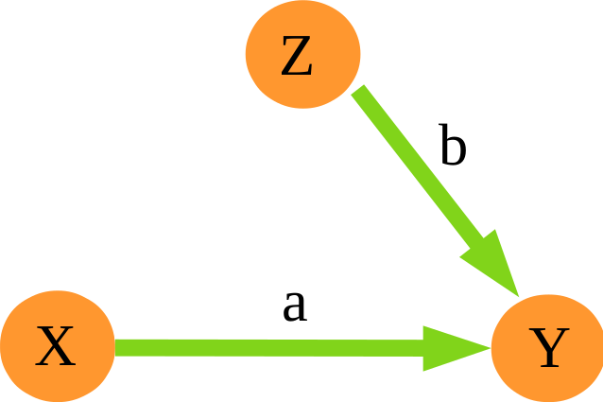
Identification of Causal Effects
Example 1: No confounding
Consider the linear SCM:
Z = η_{Z} ,
X = η_{X} ,
Y = a · X + b · Z + η_{Y} ,
2
η ∼ N (0, σ )
Z Z
2
η ∼ N (0, σ )
X
X
2
η ∼ N (0, σ )
Y
Y
26

Slide 72
Identification of Causal Effects
Example 1: No confounding
Consider the linear SCM:
Z = η_{Z} ,
X = η_{X} ,
Y = a · X + b · Z + η_{Y} ,
2
η ∼ N (0, σ )
Z Z
2
η ∼ N (0, σ )
X
X
2
η ∼ N (0, σ )
Y Y
Goal: Determine a, the causal effect of X on Y
26

Slide 73
Identification of Causal Effects
Example 1: No confounding
Consider the linear SCM:
Z = η_{Z} ,
X = η_{X} ,
Y = a · X + b · Z + η_{Y} ,
2
η ∼ N (0, σ )
Z Z
2
η ∼ N (0, σ )
X
X
2
η ∼ N (0, σ )
Y Y
Goal: Determine a, the causal effect of X on Y
Idea: Use covariance of Y on X
26

Slide 74
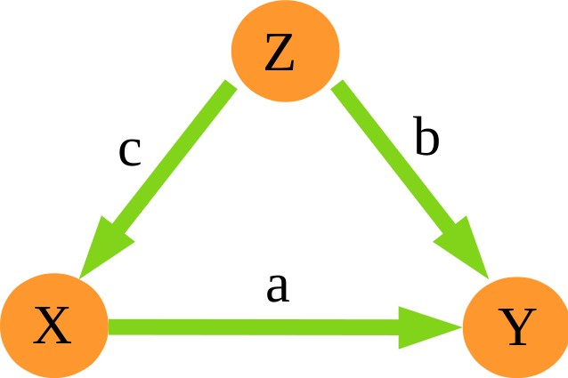
Identification of Causal Effects
Example 2: Observed confounding
Consider the linear SCM:
Z = η_{Z} ,
X = c · Z + η_{X} ,
Y = a · X + b · Z + η_{Y} ,
2
η ∼ N (0, σ )
Z Z
2
η ∼ N (0, σ )
X
X
2
η ∼ N (0, σ )
Y
Y
27

Slide 75
Identification of Causal Effects
Example 2: Observed confounding
Consider the linear SCM:
Z = η_{Z} ,
X = c · Z + η_{X} ,
Y = a · X + b · Z + η_{Y} ,
2
η ∼ N (0, σ )
Z Z
2
η ∼ N (0, σ )
X
X
2
η ∼ N (0, σ )
Y Y
Goal: Determine a, the causal effect of X on Y
27

Slide 76
Identification of Causal Effects
Example 2: Observed confounding
Consider the linear SCM:
Z = η_{Z} ,
X = c · Z + η_{X} ,
Y = a · X + b · Z + η_{Y} ,
2
η ∼ N (0, σ )
Z Z
2
η ∼ N (0, σ )
X
X
2
η ∼ N (0, σ )
Y Y
Goal: Determine a, the causal effect of X on Y
First attempt: Linearly regress of Y on X
27

Slide 77
Identification of Causal Effects
Example 2: Observed confounding
Second attempt:
Control for Z : Regress out influence of Z on
X and Y to obtain residuals ∆X and ∆Y
Linearly regress ∆Y on ∆X
28

Slide 78
Identification of Causal Effects
Example 2: Observed confounding
Second attempt:
Control for Z : Regress out influence of Z on
X and Y to obtain residuals ∆X and ∆Y
Linearly regress ∆Y on ∆X
28

Slide 79
Identification of Causal Effects
Example 2: Observed confounding
Second attempt:
Control for Z : Regress out influence of Z on
X and Y to obtain residuals ∆X and ∆Y
Linearly regress ∆Y on ∆X
28

Slide 80
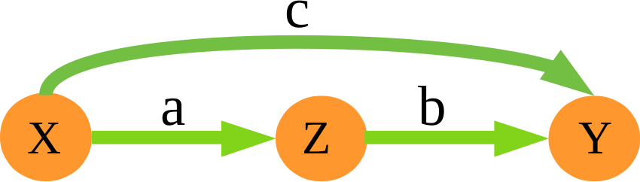
Identification of Causal Effects
Example 3: Partial mediation
Consider the linear SCM:
X = η_{X} ,
Z = a · X + η_{Z} ,
Y = b · Z + c · X + η_{Y} ,
2
η ∼ N (0, σ )
X X
2
η ∼ N (0, σ )
Z
Z
2
η ∼ N (0, σ )
Y
Y
29

Slide 81
Identification of Causal Effects
Example 3: Partial mediation
Consider the linear SCM:
X = η_{X} ,
Z = a · X + η_{Z} ,
Y = b · Z + c · X + η_{Y} ,
2
η ∼ N (0, σ )
X X
2
η ∼ N (0, σ )
Z
Z
2
η ∼ N (0, σ )
Y
Y
Total causal effect of X on Y : (a · b + c)
Linearly regress Y on X
Direct causal effect of X on Y : c
Control for Z by regressing out influence of Z on X and Y to obtain residuals ∆X and ∆Y
Linearly regress ∆Y on ∆X
Same as multivariate regression of Y on its parents (X, Z )
29

Slide 82
Conceptual Findings
Interventions model the notion of ‘experimentally manipulate X_{i}
while keeping all other conditions exactly the same’.
The causal graph allows us to decide whether a certain causal effect is identifiable.
If the causal effect is identifiable, the causal graph further allows us to estimate it from observational data.

Slide 83



Overview: Identification of Causal Effect
Example: Observed confounder
Z
X
Y
31

Slide 84
Overview: Identification of Causal Effect
Example: Observed confounder
Z
X
Y
Control for confounder Z
31

Slide 85



Overview: Identification of Causal Effect
Example: Mediation
X
Z
Y
31

Slide 86



Overview: Identification of Causal Effect
Example: Mediation
X
Z
Y
31

Slide 87
Overview: Identification of Causal Effect
Example: Mediation
X
Z
Y
Do not control for mediator Z
31

Slide 88



Overview: Identification of Causal Effect
Example: Unobserved confounder
L
unobserved
X
Y
Causal effect cannot be identified
31

Slide 89



Overview: Identification of Causal Effect
Example: Common effect
X
Y
S
31

Slide 90

Overview: Identification of Causal Effect
Example: Common effect
X
Y
S
31

Slide 91



Overview: Identification of Causal Effect
Example: Common effect
X
Y
S
Do not control for common effects of X and Y , this would introduce bias.
However, sometimes the available dataset is already biased, e.g., if samples are missing (selection bias).
31

Slide 92







Overview: Identification of Causal Effect
Example: Complicated case
Y
X
_{L}2
_{Z}4
_{Z}2
_{Z}3
_{Z}1
_{L}1
Back-door criterion:
Block all non-causal dependence by controlling for an appropriate set of variables
31

Slide 93







Overview: Identification of Causal Effect
Example: Complicated case
Y
X
_{L}2
_{Z}4
_{Z}2
_{Z}3
_{Z}1
_{L}1
Back-door criterion:
Block all non-causal dependence by controlling for an appropriate set of variables
30

Slide 94
Overview: Identification of Causal Effect
Example: Complicated case
Y
X
_{L}2
_{Z}4
_{Z}2
_{Z}3
_{Z}1
_{L}1
Back-door criterion:
Block all non-causal dependence by controlling for an appropriate set of variables
29

Slide 95




Overview: Identification of Causal Effect
Example: Unobserved confounder plus mediation
L
unobserved
X
Z
Y
Front-door criterion:
Allows to identify causal effect, but not as simple as controlling for a certain set of variables
29

Slide 96
Observational Causal Discovery

Slide 97
How to Get Causal Graphs
Relevance: Result of previous section
Knowing the causal graph of the data generating process, we can determine whether and how a causal effect can be identified from observational data
30

Slide 98
How to Get Causal Graphs
Relevance: Result of previous section
Knowing the causal graph of the data generating process, we can determine whether and how a causal effect can be identified from observational data
How to get the causal graph?
30

Slide 99
How to Get Causal Graphs
Relevance: Result of previous section
Knowing the causal graph of the data generating process, we can determine whether and how a causal effect can be identified from observational data
How to get the causal graph?
Option 1: Scientific knowledge
Talk to domain experts, general reasoning
Option 2: Observational causal discovery
Learn from observational data
30

Slide 100
Causal Graphs and (Conditional) Independencies
Fact:
The structure of the causal graph often has observable implications in terms of (conditional) independencies in the observed data.
Intuition:
Statistical dependencies derive from causal relationships
Conditioning can block and open the ‘flow of information’
31

Slide 101
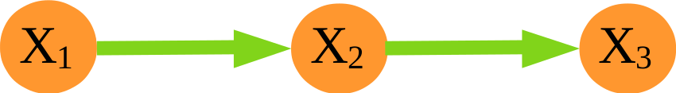
Causal Graphs and (Conditional) Independencies
Fact:
The structure of the causal graph often has observable implications in terms of (conditional) independencies in the observed data.
Intuition:
Statistical dependencies derive from causal relationships
Conditioning can block and open the ‘flow of information’
Example 1: Chain
X₁ influences X₂:
X₂ influences X₃:
X₁ influences X₃ through X₂:
Knowing X₂, X₁ does not say more about X₃:
31

Slide 102
Causal Graphs and (Conditional) Independencies
Fact:
The structure of the causal graph often has observable implications in terms of (conditional) independencies in the observed data.
Intuition:
Statistical dependencies derive from causal relationships
Conditioning can block and open the ‘flow of information’
Example 1: Chain
X₁ influences X₂:
X₂ influences X₃:
X₁ influences X₃ through X₂:
Knowing X₂, X₁ does not say more about X₃:

Slide 103
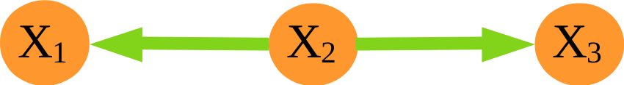
Causal Graphs and (Conditional) Independencies
Example 2: Fork
X₂ influences X₁:
X₂ influences X₃:
Observing X₁ says something about X₂ and hence
about X₃:
Knowing X₂, X₁ does not say more about X₃:
32

Slide 104
Causal Graphs and (Conditional) Independencies
Example 2: Fork
X₂ influences X₁:
X₂ influences X₃:
Observing X₁ says something about X₂ and hence
about X₃:
Knowing X₂, X₁ does not say more about X₃:
32

Slide 105
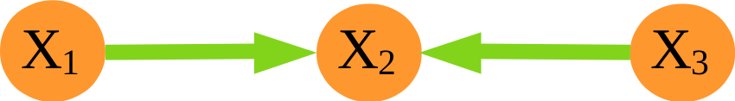
Causal Graphs and (Conditional) Independencies
Example 3: Collider
X₁ influences X₂:
X₃ influences X₂:
No influence between X₁ and X₃:
Observing X₂ introduces selection bias between
X₁ and X₃:
33

Slide 106
Causal Graphs and (Conditional) Independencies
Example 3: Collider
X₁ influences X₂:
X₃ influences X₂:
No influence between X₁ and X₃:
Observing X₂ introduces selection bias between
X₁ and X₃:
33

Slide 107
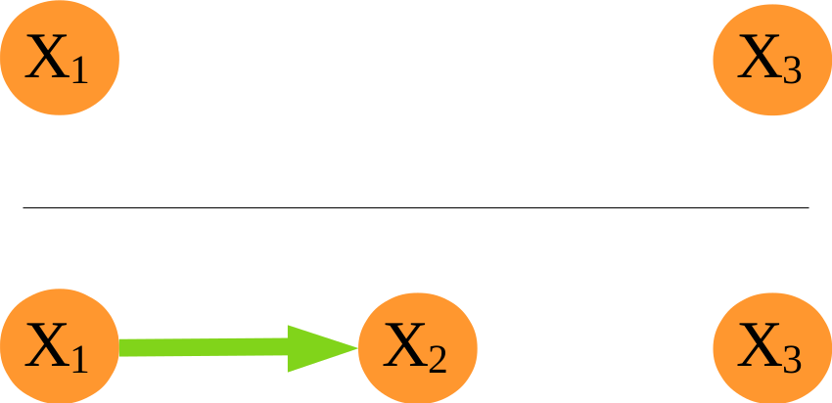
Causal Graphs and (Conditional) Independencies
Example 4: Disconnected variables
No influence between X₁ and X₃:

Slide 108
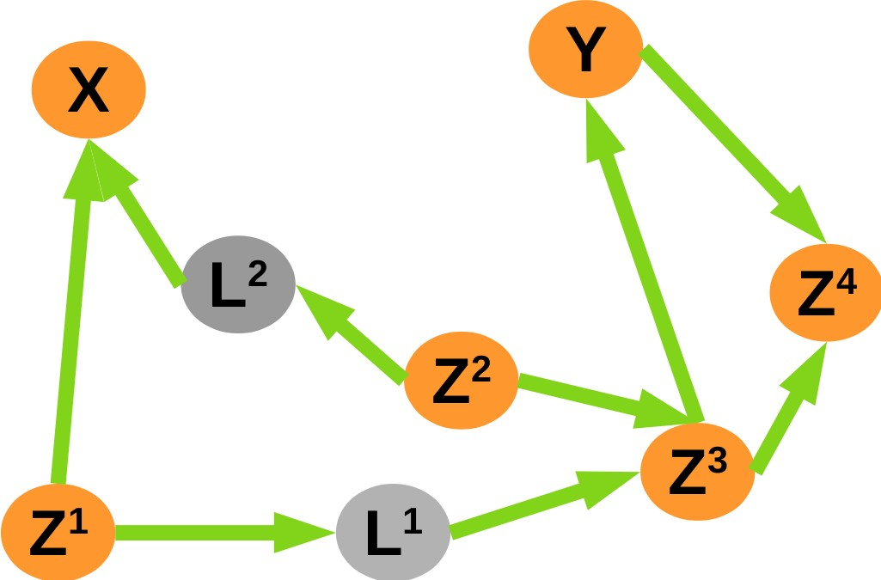
Causal Graphs and (Conditional) Independencies
General rule: d-separation
The graphical criterion of d-separation allows to read off all (conditional) independencies implied by the structure of a particular causal graph.
d-separation: Whether a set X of variables is independent of another set Y, given a third set Z. The idea is to associate "dependence" with "connectedness" (i.e., the existence of a connecting path) and "independence" with "unconnected-ness" or "separation".
Example 5: Complicated case
Some independencies implied by d-separation
Notes:
d-separation is a criterion for deciding, from a given a causal graph, whether a set X of variables is independent of another set Y, given a third set Z. The idea is to associate "dependence" with "connectedness" (i.e., the existence of a connecting path) and "independence" with "unconnected-ness" or "separation".

Slide 109
Constraint Based Causal Discovery
Idea:
Perform statistical tests of (conditional) independence in observational data
Use test results to constrain the structure of the causal graph
36

Slide 110
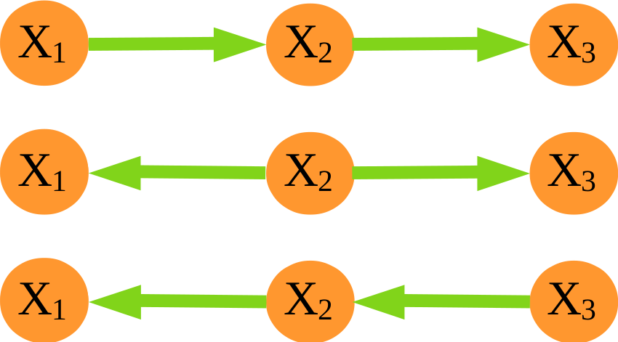
Constraint Based Causal Discovery
Idea:
Perform statistical tests of (conditional) independence in observational data
Use test results to constrain the structure of the causal graph
Example 1:
Test decisions:
Possible causal graphs:
36

Slide 111
Constraint Based Causal Discovery
Idea:
Perform statistical tests of (conditional) independence in observational data
Use test results to constrain the structure of the causal graph
Example 1:
Test decisions:
Possible causal graphs:
observationally equivalent graphs
36

Slide 112
Constraint Based Causal Discovery
Idea:
Perform statistical tests of (conditional) independence in observational data
Use test results to constrain the structure of the causal graph
Example 2:
Test decisions:
Possible causal graphs:
37

Slide 113
Constraint Based Causal Discovery
Idea:
Perform statistical tests of (conditional) independence in observational data
Use test results to constrain the structure of the causal graph
Example 2:
Test decisions:
Possible causal graphs:
observationally equivalent graphs
37

Slide 114
Required Assumptions
Recall:
Causal questions cannot be answered from observational data without making any additional assumptions.
38

Slide 115
Required Assumptions
Recall:
Causal questions cannot be answered from observational data without making any additional assumptions.
Assumption 1: Existence of SCM
The data generating process can be described as an SCM. This implis the so called causal Markov condition:
d-separation in causal graph ⇒ (conditional) independence
Assumption 2: Faithfulness
d-separation in causal graph
(conditional) independence ⇒
Assumption 3: Causal sufficiency
There are no unobserved confounders and there are no selection variables.
38

Slide 116
Required Assumptions
Recall:
Causal questions cannot be answered from observational data without making any additional assumptions.
Assumption 1: Existence of SCM
The data generating process can be described as an SCM. This implis the so called causal Markov condition:
d-separation in causal graph ⇒ (conditional) independence
Assumption 2: Faithfulness
d-separation in causal graph
(conditional) independence ⇒
Assumption 3: Causal sufficiency
There are no unobserved confounders and there are no selection variables.
Assumption 3 can be dropped (but much more complicated) Assumption 2 can be relaxed
38

Slide 117
Some Famous Algorithms
SGS-Algorithm:
Tests all possible (conditional) independence statements, use results to constrain the causal graph as discussed in the examples.
SGS stands for S pirtes, G lymour, and S cheines.
PC-Algorithm:
Based on SGS-Algorithm, but using much fewer conditional independence tests.
PC stands for Peter Spirtes and C lark Glymour.
FCI-Algorithm:
Similar to the PC-Algorithm, but without requiring the assumption of causal sufficiency, i.e., allowing for hidden confounders and selection variabes.
FCI stands for f ast causal i nference.

Slide 118
Two Main Approaches of Causal Discovery
Constraint-based causal discovery:
Constrain causal graph by using results of conditional independence tests in observational data.
⇒ discussed
SCM-based causal discovery:
Make assumption on functional causal relationships (e.g., linear or non-linear) and noise distributions (e.g., Gaussian or non-Gaussian) of data generating SCM.
Generically, model can fit in one direction only. This allows to identify direction of causal influence.
⇒ not discussed

Slide 119
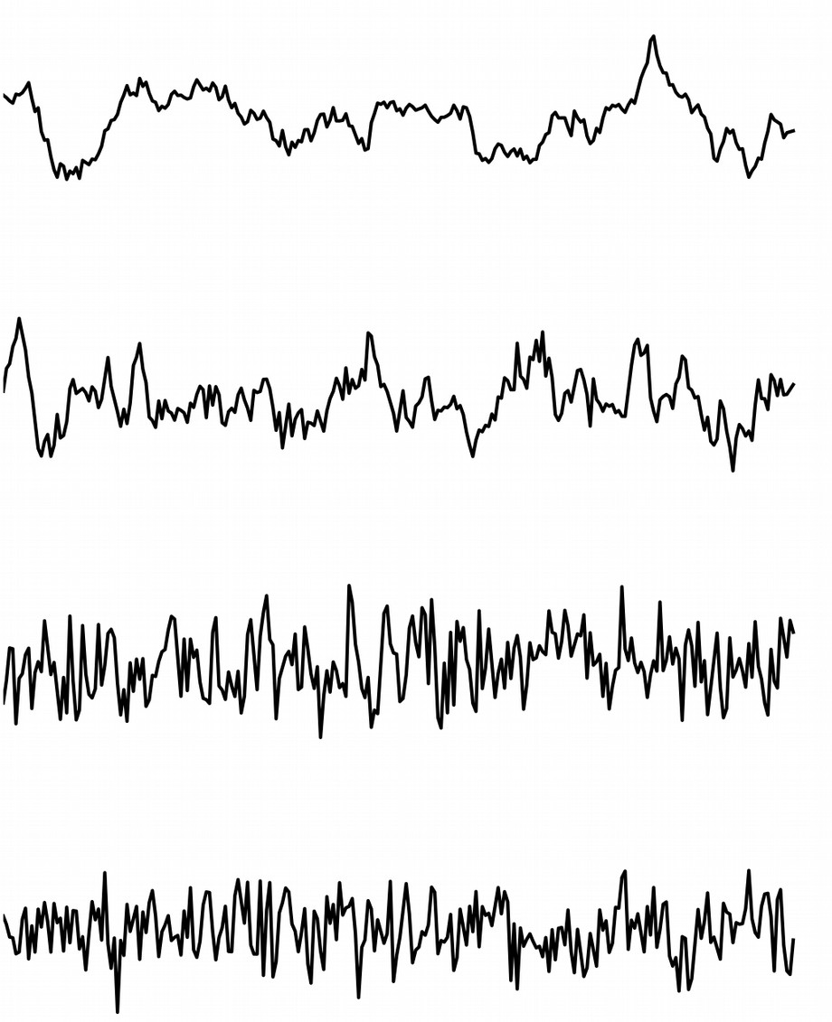
Causal Discovery in Time Series
_{X}1
_{X}2
_{X}3
_{X} 4
41

Slide 120















Causal Discovery in Time Series
t−3 t−2 t−1
_{X}1
t
_{X}2
_{X}3
_{X} 4
41

Slide 121
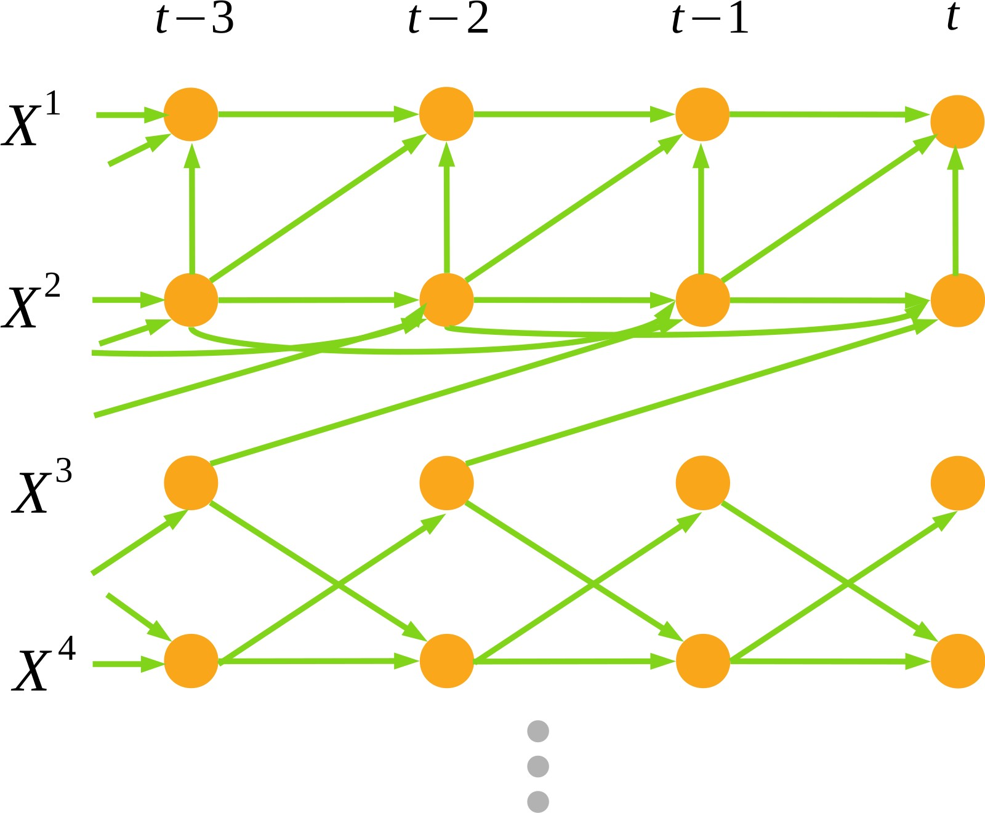
Causal Discovery in Time Series
Observations in time make things easier:
Additional constraint: Causation cannot go back in time.
Observations in time make things harder:
High dimensionality: Resolving in time increases the number of variables
Statistical issues: Autocorrelation makes conditional independence tests statistically harder

Slide 122
Causal Discovery in Time Series
Observations in time make things harder:
High dimensionality: Resolving in time increases the number of variables
Statistical issues: Autocorrelation makes conditional independence tests statistically harder
PCMCI-Algorithm:
Adaption of the PC (Peters/Clark)-algorithm to time series in which these challenges are addressed.
43

Slide 123
Alternative Concept: Granger Causality
Idea:
X causes Y if the past of X helps in predicting the Y from its own past.
Limitations:
Requires causal sufficiency
Does not allow contemporaneous interactions

Slide 124







State of the art: see Runge et al. NatComm 2019
a Granger causality
b Nonlinear state-space methods
M
(X(t), Y(t), Z(t))
M_{X}
M_{Y}
_{(X(t), X(t-d), X(t-2d))} (Y(t), Y(t-d), Y(t-2d))
c Causal network learning algorithms
Skeleton discovery phase
d Structural causal models
Linear Non-Gaussian Additive Model
Orientation phase
p=0
t −2 t −1 t
p=1
t −2 t −1 t
p=2
t −2 t −1 t
t −2 t −1 t
X =f (Y , E^{X} )
t t t _{r} X
X
t
Y
X_{t}
Y_{t}
Z
Y_{t}
Y =g ( X , E^{Y} )
t t t _{r} Y
t
W
X_{t}

Slide 125
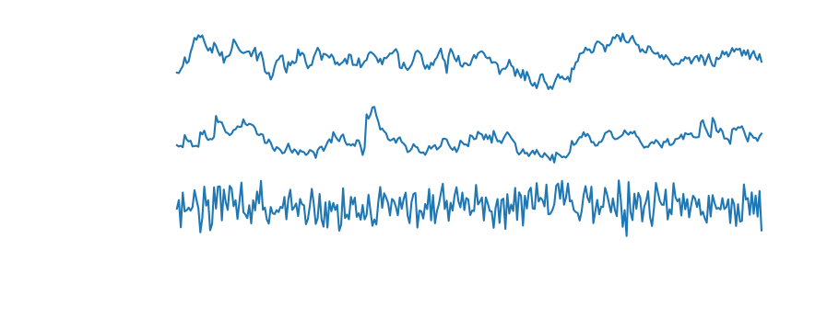



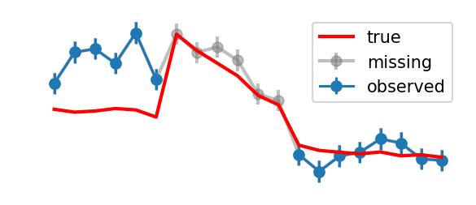

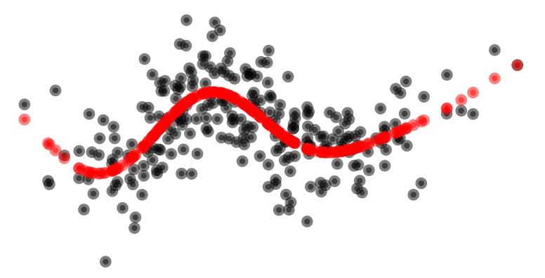

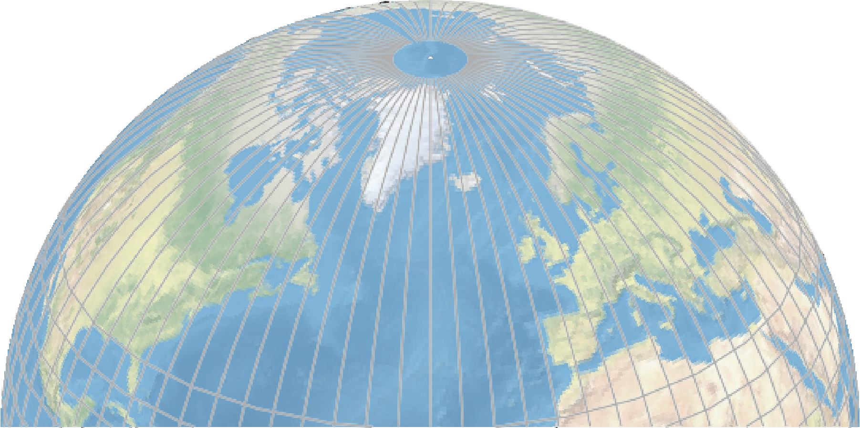
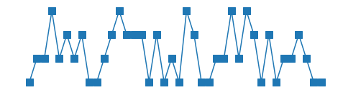


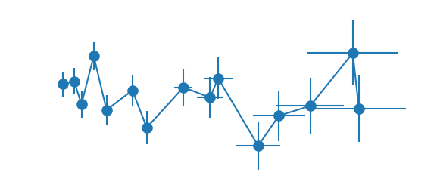

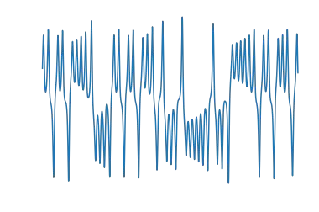
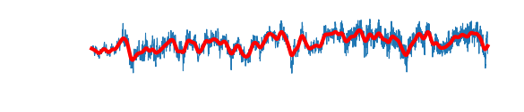
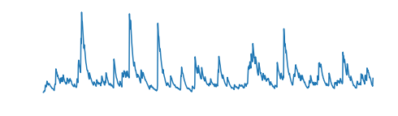
Real world challenges: see Runge et al. NatComm 2019
Challenges
15
t −5 t −4 t −3 t −2 t −1 t
9 _{X}
Y
Process:
16
Autocorrelation
Time delays
Nonlinear dependencies
Chaotic state-dependence
Different time scales
Noise distributions
10 ^{X} Y
t −3 t −2 t −1
t
U
8
X
X
2
Y
Data:
Variable extraction
Unobserved variables
Time subsampling
Time aggregation
Measurement errors
Selection bias
Discrete data
Dating uncertainties
7 months 17
3
Y
11
12
1
Z
W
13
7
7
Computational / statistical:
Sample size
High dimensionality
Uncertainty estimation
14
4
5
6

Slide 126
Summary
Causal inference:
Answering causal questions from empirical data
47

Slide 127
Summary
Causal inference:
Answering causal questions from empirical data
Two settings:
47

Slide 128
Summary
Causal inference:
Answering causal questions from empirical data
Two settings:
Causal graph assumed known → estimate causal effects
47

Slide 129
Summary
Causal inference:
Answering causal questions from empirical data
Two settings:
Causal graph assumed known → estimate causal effects
Causal graph unknown → causal discovery (→ then causal effects)
47

Slide 130
Summary
Causal inference:
Answering causal questions from empirical data
Two settings:
Causal graph assumed known → estimate causal effects
Causal graph unknown → causal discovery (→ then causal effects)
Causal inference requires assumptions
47

Slide 131
Summary
Causal inference:
Answering causal questions from empirical data
Two settings:
Causal graph assumed known → estimate causal effects
Causal graph unknown → causal discovery (→ then causal effects)
Causal inference requires assumptions
Underlying SCM / Causal Markov Condition
47

Slide 132
Summary
Causal inference:
Answering causal questions from empirical data
Two settings:
Causal graph assumed known → estimate causal effects
Causal graph unknown → causal discovery (→ then causal effects)
Causal inference requires assumptions
Underlying SCM / Causal Markov Condition
Faithfulness (for causal discovery)
47

Slide 133
Summary
Causal inference:
Answering causal questions from empirical data
Two settings:
Causal graph assumed known → estimate causal effects
Causal graph unknown → causal discovery (→ then causal effects)
Causal inference requires assumptions
Underlying SCM / Causal Markov Condition
Faithfulness (for causal discovery)
Potentially causal sufficiency
47

Slide 134
Summary
Causal inference:
Answering causal questions from empirical data
Two settings:
Causal graph assumed known → estimate causal effects
Causal graph unknown → causal discovery (→ then causal effects)
Causal inference requires assumptions
Underlying SCM / Causal Markov Condition
Faithfulness (for causal discovery)
Potentially causal sufficiency
Assumptions on dependency types (linearity, etc) and distributions
47

Slide 135
Summary
Causal inference:
Answering causal questions from empirical data
Two settings:
Causal graph assumed known → estimate causal effects
Causal graph unknown → causal discovery (→ then causal effects)
Causal inference requires assumptions
Underlying SCM / Causal Markov Condition
Faithfulness (for causal discovery)
Potentially causal sufficiency
Assumptions on dependency types (linearity, etc) and distributions
Time series data: time order, stationarity, ...
47

Slide 136
Summary
Causal inference:
Answering causal questions from empirical data
Two settings:
Causal graph assumed known → estimate causal effects
Causal graph unknown → causal discovery (→ then causal effects)
Causal inference requires assumptions
Underlying SCM / Causal Markov Condition
Faithfulness (for causal discovery)
Potentially causal sufficiency
Assumptions on dependency types (linearity, etc) and distributions
Time series data: time order, stationarity, ...
These assumptions can sometimes not be tested from the same data or even any empirical data
47

Slide 137
Summary
Causal inference:
Answering causal questions from empirical data
Two settings:
Causal graph assumed known → estimate causal effects
Causal graph unknown → causal discovery (→ then causal effects)
Causal inference requires assumptions
Underlying SCM / Causal Markov Condition
Faithfulness (for causal discovery)
Potentially causal sufficiency
Assumptions on dependency types (linearity, etc) and distributions
Time series data: time order, stationarity, ...
These assumptions can sometimes not be tested from the same data or even any empirical data
Causal conclusions require to
47

Slide 138
Summary
Causal inference:
Answering causal questions from empirical data
Two settings:
Causal graph assumed known → estimate causal effects
Causal graph unknown → causal discovery (→ then causal effects)
Causal inference requires assumptions
Underlying SCM / Causal Markov Condition
Faithfulness (for causal discovery)
Potentially causal sufficiency
Assumptions on dependency types (linearity, etc) and distributions
Time series data: time order, stationarity, ...
These assumptions can sometimes not be tested from the same data or even any empirical data
Causal conclusions require to
state assumptions and explain reasons for believing them
47

